Slide 1

StableSwap
Simon Zhang Viseth Auk Toby Martin

Slide 2


Slide 3
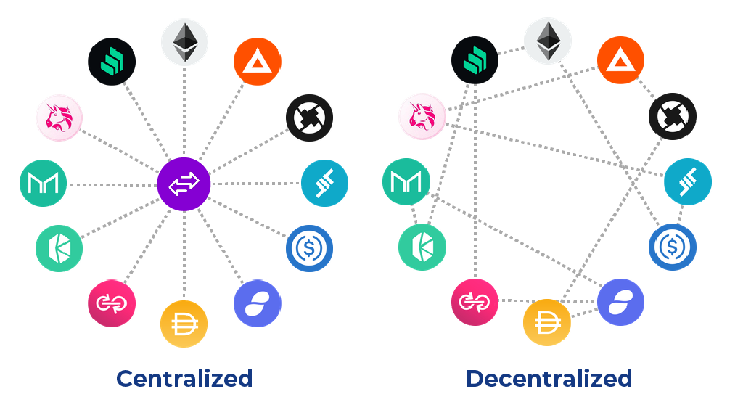
Centralised
Decentralised
Custodians of funds
Orderbook system
Know Your Customer (KYC)
Central body replaced with smart contract/code
Orderbook replaced with AMM
Do not require KYC
Tokens traded must be on same blockchain
Little support

Slide 4
COSTS ON DEXs
Orderbook replaced with automated market maker (AMM)
DEX keeps balance of liquidity between each trading pair
Price impact determined by the ‘buy’ amount and the effect it has on the liquidity of the token on the exchange.
Blockchain transaction fees – fee to use the network
Slippage cost - the percentage amount that the purchaser chooses to potentially pay over their asking price to ensure their trade goes through

Slide 5
Project Motivation
To create a platform to allow users to swap tokens similar to BeeSwap, UniSwap and Sushi Swap
Our goal is to provide a cheaper fee structure than these competitors
We hope that this will bring more people to our platform
Our Fee Structure
fees = (1-portion of total liquidity of output token) * 0.1%
if all pools have same liquidity, should expect average fee of 0.067%
Downside
We have less fees so liquidity providers may earn less interest compared to traditional LPs.
However, we hope that since we have lower fees, we will have a greater volume which will offset the lower interest.
Furthermore, we expect volume to move from traditional LPs over to our platform, thus lowering the interest rates of traditional LPs anyway

Slide 6
Project Purpose
We aim to use the decentralised network to provide non-custodial financial products to replace centralized middlemen in financial applications such as loans, insurance and derivatives.
To try and solve the liquidity problem by allowing users to swap tokens without relying on buyers and sellers creating that liquidity. We do this by rewarding the maker of that liquidity a portion of our fee earnings from the swap without them having to risk their money investing on other risky assets or investment portfolio.
Allow anyone, from anywhere to supply tokens to our liquidity pool for interest, trade tokens, and take out collateralized loans.

Slide 7
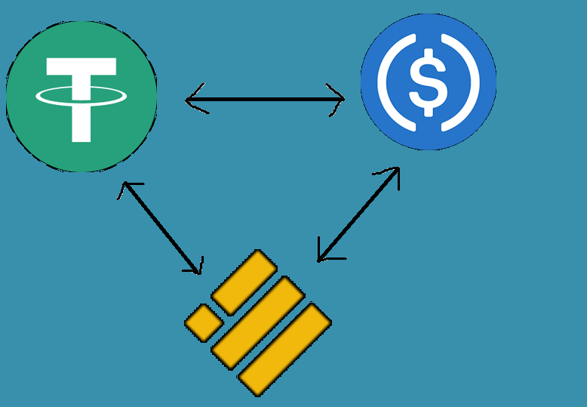
Stableswap
3-sided liquidity pool (LP)
BUSD, USDT and USDC
Infinitely scalable pools
Reduce swap fees
Create interest for depositors
Give over-collateralized loans
Platform collects 10% of all fees
Stable Coin: cryptocurrency designed to be pegged to a specific value, in this case, 1 USD.

Slide 8
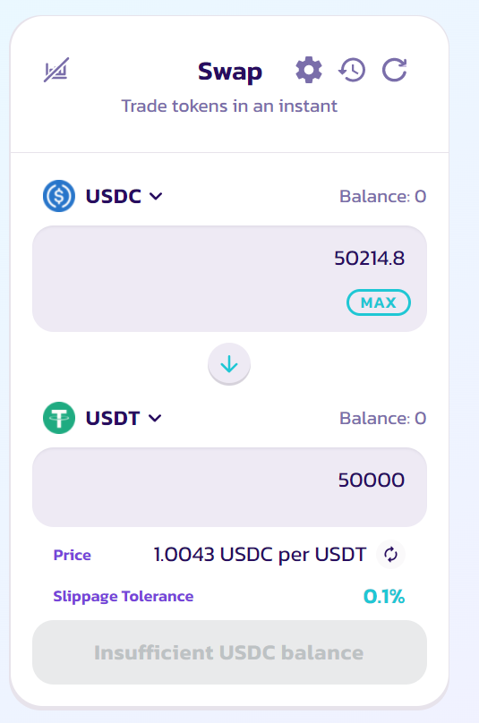
No more price impact fees
Stable coins are stable – price impact innately makes no sense
Creates loss for traders and investors
Income for arbitrage bots exploiting this inefficiency
Solution:
Scaling variable rate fee → upper bound for price impact
Will scale between near 0% to a maximum of 0.1%
$214.8 total fee
$125 gone to liquidity providers
$89.8 gone to price impact
At StableSwap, our max fee
for a $50k trade is $50.

Slide 9
Game Changer for capital efficiency
Double utilisation of funds
Additional income source for depositors leading to higher returns
Currently all done manually
Full release will include automated loan approval and liquidations
20% initial interest rate for stable coins
For reference, Binance charges 20.8% interest for margin trading stable coins
Anchor Protocol gives approximately 19% APY (daily compound) on Tera USD (UST)

Slide 10
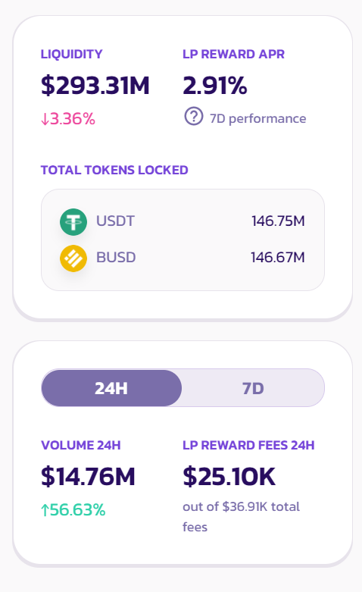
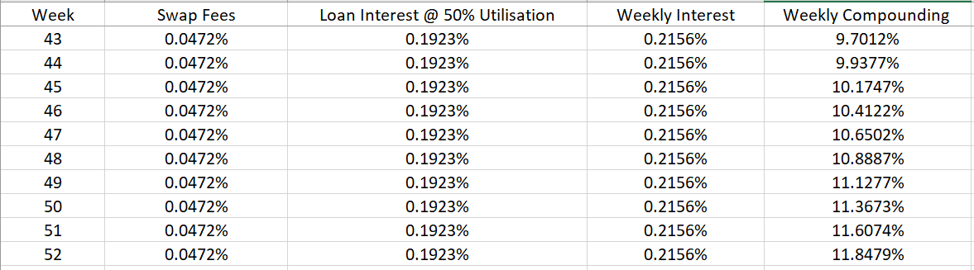
Long term usage statistics and modelling
Hypothetical numbers using extrapolated data from Alpaca Finance and PancakeSwap
Note: weekly interest includes platform fees
PancakeSwap LP usage

Slide 11
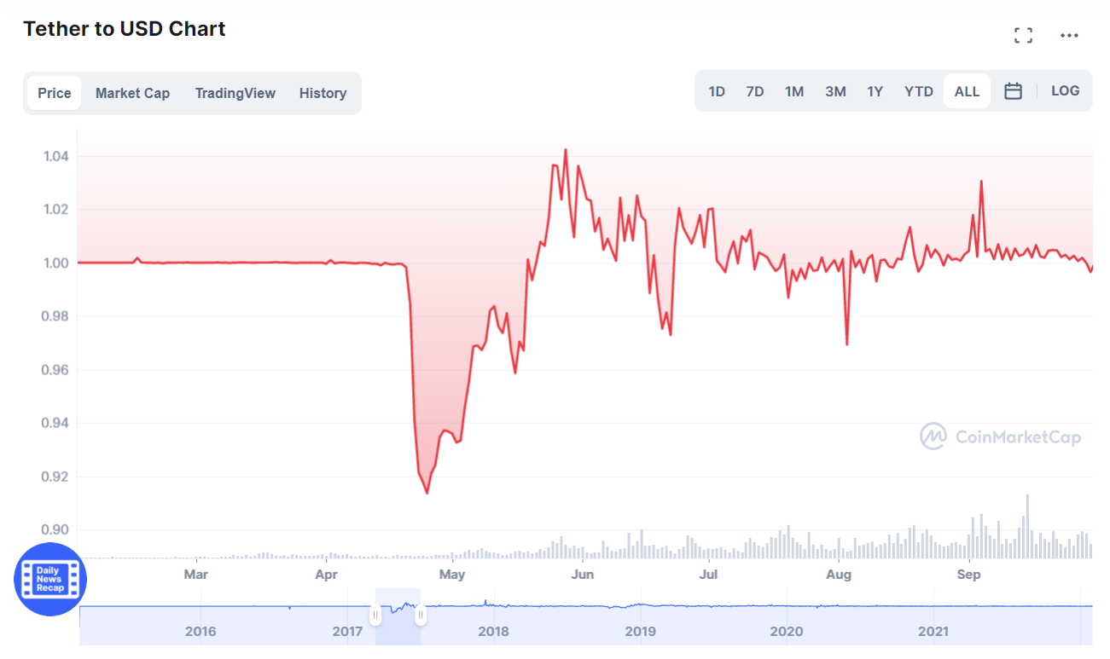
Potential Improvements
Maximum liquidity ratio
In the event one asset trades at significantly lower
USDT crash in 2017 amidst subpoena fears
Auto approve and liquidation of loans
Fee incentives for input tokens
Further decimal precision
Scaling interest rate for loans
Use events for gas efficiency
Further bug testing

